Slide 1

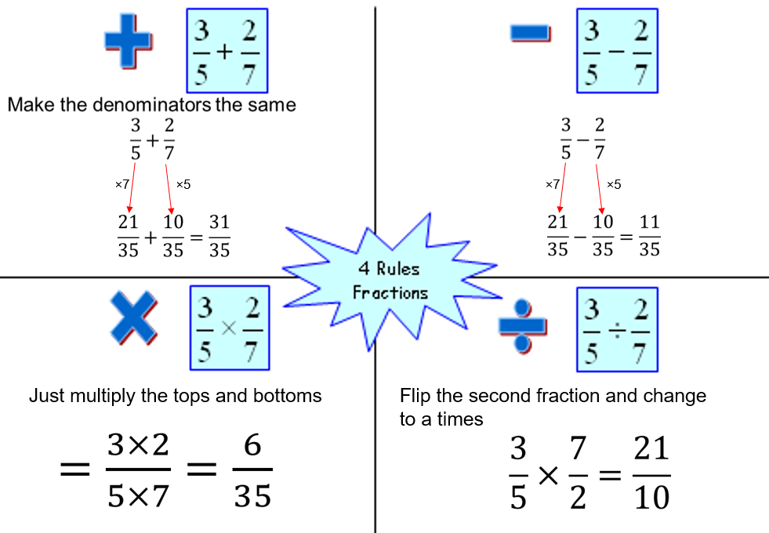


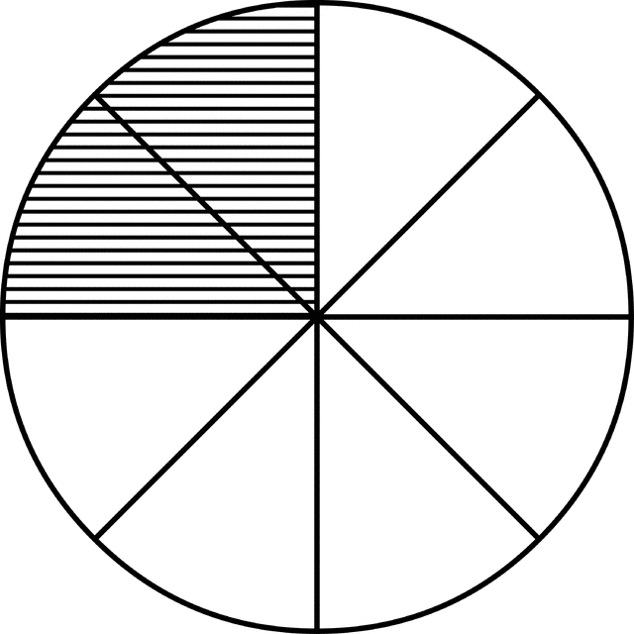
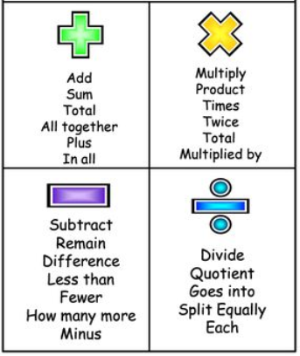
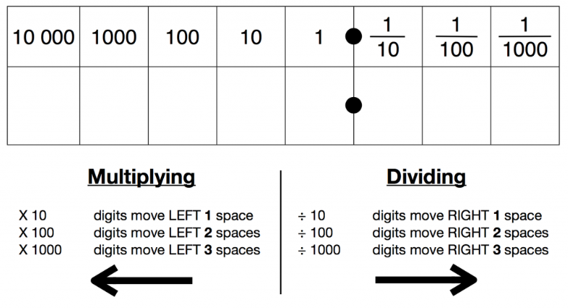

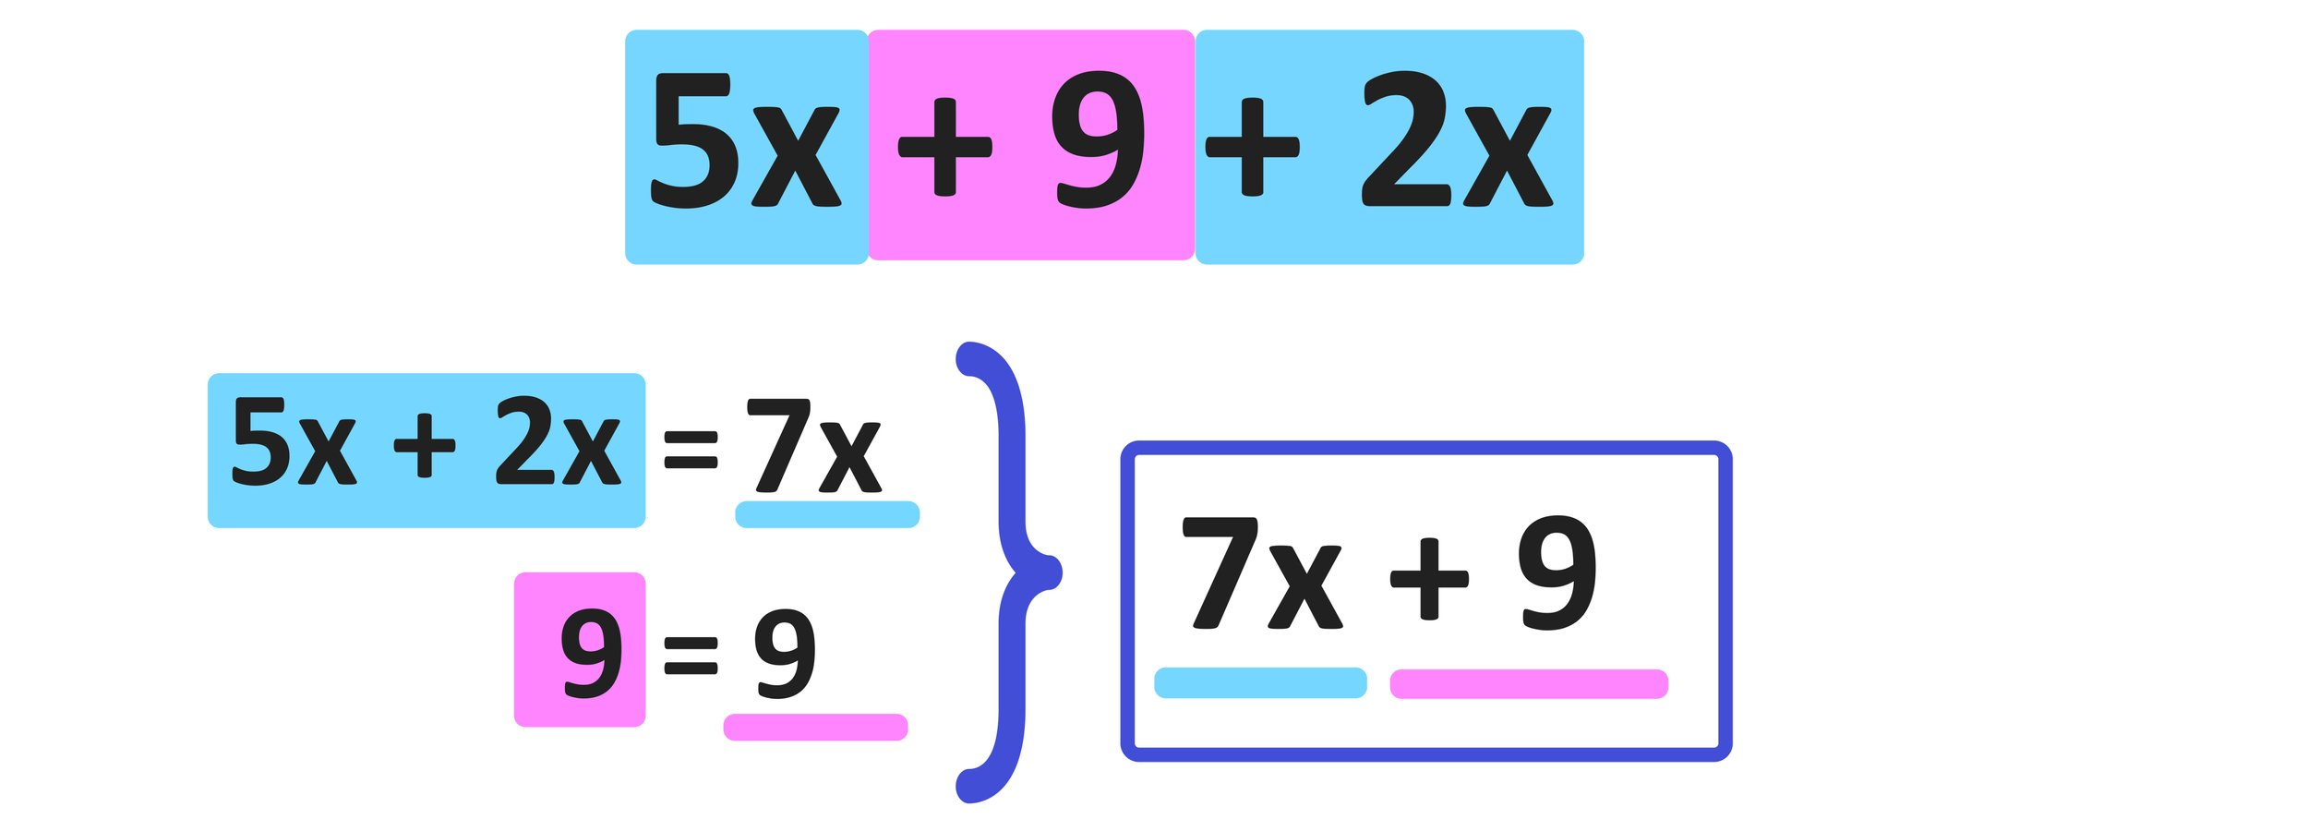




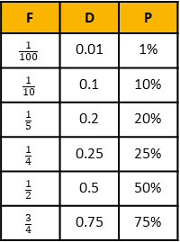

Maths
Year 7 Number
Key Concept
Mixed numbers
These are made up of a whole number and a fraction.
$$4\frac{3}{5}$$
$$=\frac{4×5+3}{5}$$
$$=\frac{23}{5}$$
Key Concept
FDP Equivalence
Key Concept
$$\frac{1}{4}$$
$$\frac{1}{4}=\frac{2}{8}=\frac{3}{12}=\frac{4}{16}$$
= 0.25
Examples
F | D | P
$$\frac{1}{100}$$ | 0.01 | 1%
$$\frac{1}{10}$$ | 0.1 | 10%
$$\frac{1}{5}$$ | 0.2 | 20%
$$\frac{1}{4}$$ | 0.25 | 25%
$$\frac{1}{2}$$ | 0.5 | 50%
$$\frac{3}{4}$$ | 0.75 | 75%
Key Words
Equivalence: Two fractions are equivalent if one is a multiple of the other.
Simplify: Cancel a fraction down to give the smallest numbers possible.
Key Words
Place Value: The value a digit takes when placed in a particular position of a number.
Key Concept
Multiply/Divide by powers of 10
Key Concept
Factors:
Find these in pairs
12
1, 12
2, 6
3, 4
Multiples:
Start with the number itself
7 – 7, 14, 21, 28, …
Year 7 Algebra
Key Concept
Inverse Operations
Key Concept
Expanding Brackets
To multiply out brackets, we use the grid method.
$$5\left(x+9\right)$$
=5$x$ + 45
7x(3x-2)
=35$x$ -14
Key Concept
Collecting Like Terms
x | $$x$$ | + 9
5 | 5$x$ | + 45
x | $$3x$$ | -2
7$x$ | 35$x$ | -14
Key Words
Unknown: A letter which represents a number we do not know the value of.
Terms: The numbers and letters in the expression or equation.
Inverse: The operation which will do the opposite.

Slide 2
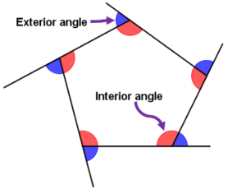
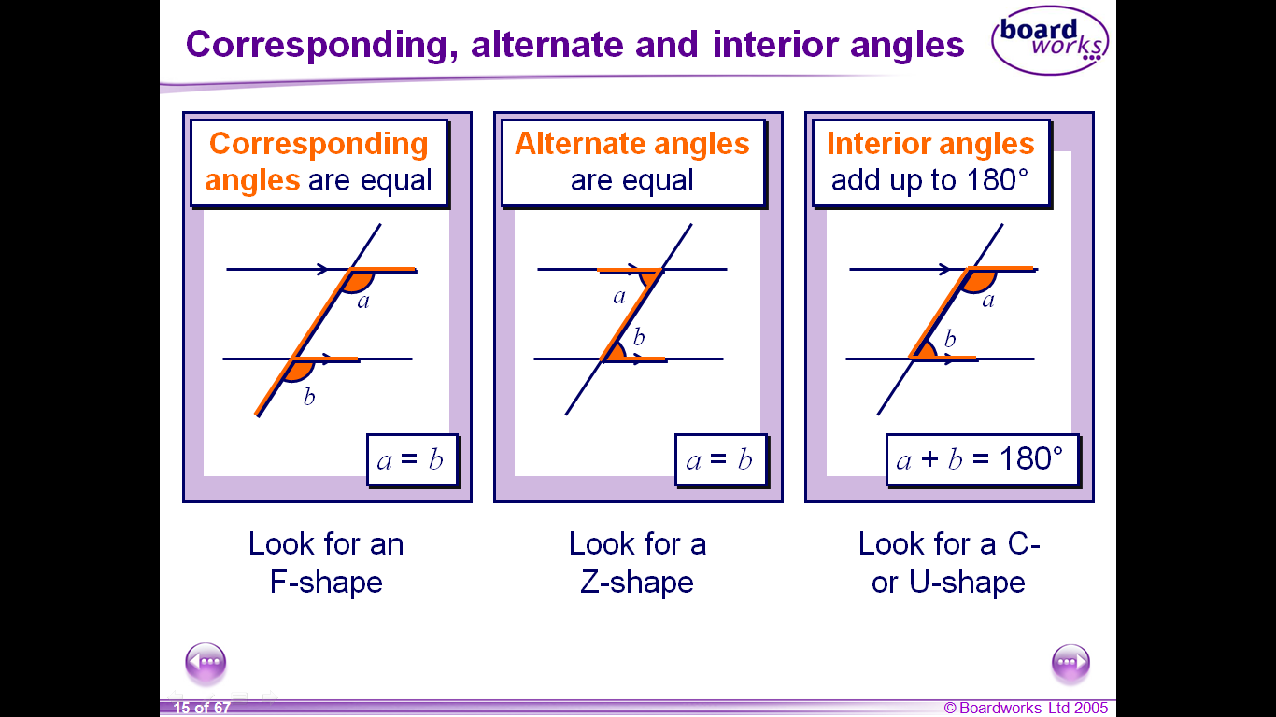
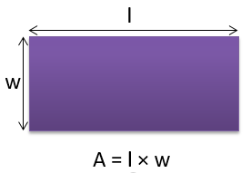
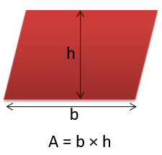
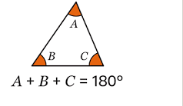
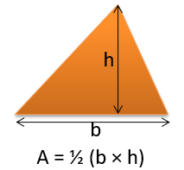
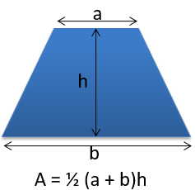
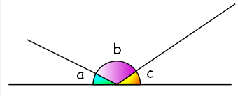
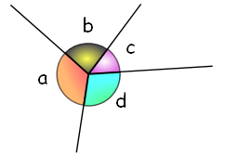
Maths
Year 7 Geometry
Key Concepts
Key Concepts
Key Concepts
Area
Angles in a triangle add to 180 °
Corresponding angles are equal.
Alternate
angles are equal.
Angles at a point
add to 360°
Co-interior
angles add to 180°.
Angles on a line
add to 180°
Key Words
Parallel: Two lines that are always the same distance apart.
Perimeter: The distance around the outside of a shape.

